Slide 1
The Design of Naming Schemes

Slide 2
Outline
Considerations
URL
Pathologies

Slide 3
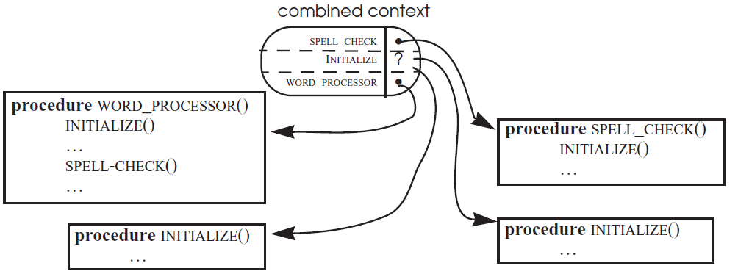
Name Conflict
Module sharing by name
  Not knowing the names of the components the shared module uses

Slide 4
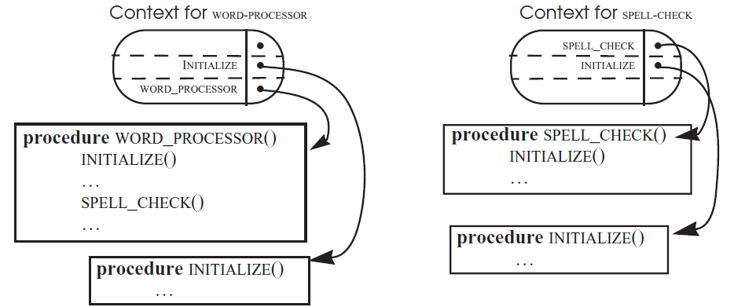
Name Conflict

Slide 5
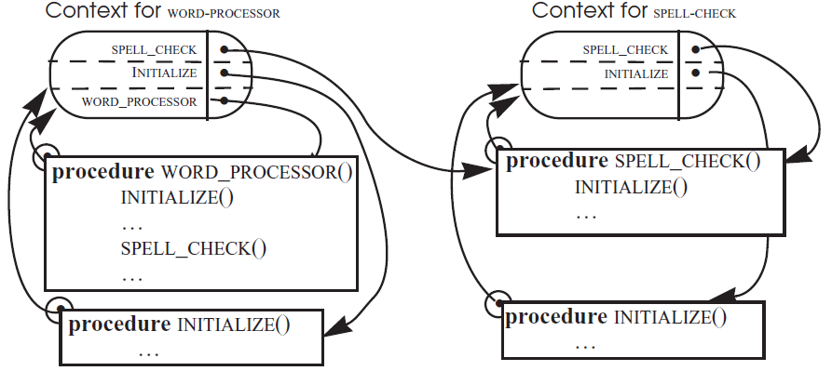
Attach Each Module an Explicit Context Reference

Slide 6
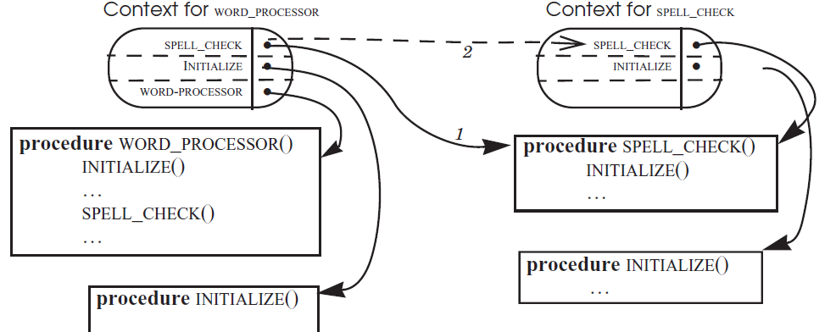
Using Context in which it found each program

Slide 7
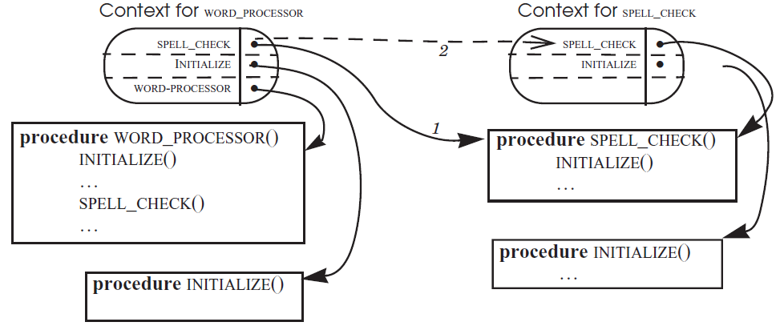
Track and indirect

Slide 8
Name conflict
Associate the name of an object with
  The object & the reference
Closure
  Some programming languages implement it to a procedure definition

Slide 9
Name conflict
definition
def counter():
x = 0
def increment(y):
nonlocal x
x += y print(x)
return increment
counter1_increment = counter()
counter2_increment = counter()
counter1_increment(1) # prints 1 counter1_increment(7) # prints 8 counter2_increment(1) # prints 1 counter1_increment(1) # prints 9

Slide 10
Metadata （as information in inode）
Information that is useful to know about an object, but that can not be found inside the object itself
  a user-friendly name, a unique identifier
  the type of the object (exe,doc,ppt)
  the dates it was created, last modified, last backed up
  the location of backup copies
  the name of its owner
  a cryptographic quality checksum
  the list of names of who is permitted to read or update the object
  the physical location of the representation of the object

Slide 11
Metadata
Metadata （inode） is in file system
When changing metadata, the object may not be changed

Slide 12
Metadata
Metadata → only for machine to manage files
  Not for user (not support user-supplied metadata (except the file name )
Name overloading
  Use name to keep more metadata

Slide 13
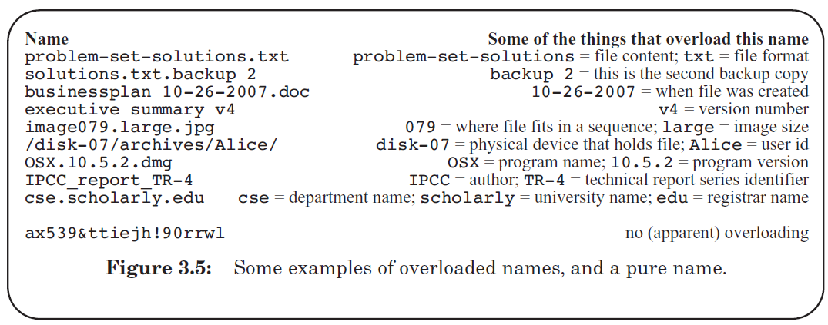
Overloading

Slide 14
Overloading
Fragile name
  /disk5/library/sqrt → /disk6/library/sqrt
User performs metadata extraction
  CityClerk.Reston.VA.US

Slide 15
Address
Name of physical/virtual location
  Use as locator → Maps to physical location
  Used as a ID
set of integers
  address adjacency ←-----→ physical adjacency
  Arithmetic operation can be applied → *(p++)
  Telephone switching system is different
    It was the same decades ago

Slide 16
Address
Address as Name ----→ fragility
  Object moves → name changes
Decouple modules with indirection
  Externally : visible 、 stable name
  Internal addresses： never be exposed
  Example： Com1 instead of 0x4D7C
Addresses are used to locate objects efficiently
  Usually appears in low layers

Slide 17
Address
How to handle name changing when address is used
  Search for and change all （ if you change your phone number）
    Sometimes may miss some used the old address
    Not-found or leads to a different object
  Undertake an attribute-base search if not-found or rebound to a different object detected
  two addresses indentify the same object
  place an intermediary

Slide 18
Generating Unique Names
Time stamp
Random chosen
  Name collision
File content ---→ file name
  same content have the same name
    Maybe very long
  Hash (Secure Hash Algorithm)
  Fragile (handle content change)
Another use of the unique names
  Name a temporary file

Slide 19
Generating Unique Names
Hierarchical naming scheme
  Delegation
  Decentralized, “edu”, “com” etc.
MAC network address
  48-bit
  Allocate ……….. to manufacturer
  No information for location
  MAC not changed, the computer changed

Slide 20
Intended Audience
For people
  User-chosen, user-friendly strings of characters
  Mnemonic value,
  ……
For machines
  Typically integers, often fixed width
  …..
  identifier
  …..
Notes:
For machines
Unambiguous
Identifier
Chosen mechanically

Slide 21
User-Friendly Names
A tension between
  Unique and easily resolvable identifier
  V.S.
  Being easy to remember
a second machine -------- use identifier
  Billing systems

Slide 22
User-Friendly Names
Case-sensitive
  At very beginning, …..
  In 1965, Multics ……
    “Court docket 5” and “Court Docket 5” can be bound to different files
  The Unix file system copied the mistake
Case-coercing
  All names are both coerced to and stored in one case

Slide 23
User-Friendly Names
Case-preserving
  Coerce all alphabetic characters to the same case when doing name comparisons (DNS,URL )
Other user-friendly names
  The shape icon in GUI
  Corss-linking in MIT Shakespeare

Slide 24
Relative Lifetimes of Names, Values, and Bindings
Name space may be limited
  limited names are dynamically bound
  Name must be reuse
  Allocation/deallocation are used to replace bind/unbind
  not chosen by users
    Phone number assigned by the authority
    File names chosen by users

Slide 25
Relative Lifetimes of Names, Values, and Bindings
Names and values are often long-lived,
bindings are more transient
  Personal names A → phone numbers N
  Personal names A phone numbers N → person B
  A program --→ OS interfaces
    Easy to modify both of them
  Network service -→ its IP address

Slide 26
Dangling Reference
Name outlives >>> its binding
Using dangling reference, resolves to
  Not-found
  an irrelevant value
An irrelevant value
  Often happens in the limited name space
  damage the unrelated object
  “Hi, are you **， and you failed the exam last year ?”

Slide 27
Dangling Reference
File system
  soft link exists >>> target removed
distributed system ( www )
  Bindings widely dispersed
  Needs stable binding
  Dangling reference in WWW

Slide 28
Lost Object
Object outlives >> every name
  Orphan
Storage leak
Reference count scheme
  Keep track the bindings -→ object
  Reclaim the storage when the number becomes zero by unbinding
Garbage collection

Slide 29
Uniform Resource Locator (URL)
Name discovery
Interpretation of the URL
  Protocol, DNS, pathname
  Partial URL and base element
URL case sensitive
Resolve a partial URL
Overloading of Names in URLs

Slide 30
Name discovery
Hyperlink
  <a href="http://web.pedantic.edu/Alice/www/home.html"> Alice’s home page</a>
Retrieve a page in the WWW
Many URLs can be found in hyperlinks on other Web pages
Most Web browser come with one or more built-in Web pages
See URL mentioned in a newspaper advertisement

Slide 31
Interpretation of the URL
http://web.pedantic.edu/Alice/www/home.html
http:
  Name of a network protocol
  Resolved to a protocol handler, in the browser
Host name
  web.pedantic.edu
  Solved by DNS, returns IP address

Slide 32
Interpretation of the URL
connection
  Browser opens a connection to the server at the above IP address
  Using the protocol
    Sends the /Alice/www/home.html to the server as the 1st step of the protocol
Server looks for a file
Server sends the file back
Client display

Slide 33
Interpretation of the URL
Partial (relative) URL
  <a href="contacts.html">How to contact Alice.</a>
  Relative URL
Browser tries to resolve the partial URL
  Find a context which is the page in which the URL is found
  http://web.pedantic.edu/Alice/www/contacts.html
Can be base on the base element
  <base href="some absolute URL">

Slide 34
URL case sensitive
Protocol part
  Depends on browser implementation at the client side
  Macintosh implementation of Firefox uses case-preserving
  Obsolete Macintosh IE is case-coercing
Host name part
  Interpreted by DNS which is case-insensitive
The rest part is interpreted by the server
  Protocol dependent. In Http
    not a unix file name but silent on case-sensitive
    Usually treated as a path name

Slide 35
Wrong Context References for a Partial URL
Server provides a URL name space by using the local file system name space
If the local file system provides synonyms, URL is not unique
  1 http://web.pedantic.edu/ alice/home.html
  2 http://web.pedantic.edu/ alice/www/home.html
<a href = "contacts.html">
  1 http://web.pedantic.edu/alice/contacts.html
  2 http://web.pedantic.edu/alice/www/contacts.html

Slide 36
Wrong Context References for a Partial URL
Server provides a URL name space by using the local file system name space
If the local file system provides synonyms, URL is not unique
  1 http://web.pedantic.edu/alice/home.html
  2 http://web.pedantic.edu/alice/www/home.html
<a href = "contacts.html">
  1 http://web.pedantic.edu/alice/contacts.html
  2 http://web.pedantic.edu/alice/www/contacts.html

Slide 37
Wrong Context References for a Partial URL
<a href=”../phone.html”>
  1 http://web.pedantic.edu/alice/../phone.html
  2 http://web.pedantic.edu/alice/www/../phone.html
Results
  1 http://web.pedantic.edu/phone.html
  2 http://web.pedantic.edu/alice/phone.html
Syntactic and semantic interpretation
Syntactic interpretation need a unique URL

Slide 38
Overloading of Names in URLs
http://www.amazon.com/exec/obidos/ASIN/0670672262/o/qid=921285151/sr=2-2/002-7663546-7016232
The server has encoded the state of the shopping session, in the form of an identifier of a state maintaining file at the server
http://www.google.com/search?hl=en&q=books+about+systems&btnG=Google+Search&aq=f&oq=
the string up to the question mark is the name of a program
the string after the question mark is an argument to be given to that program

Slide 39
War Stories
A name collision eliminates smiling faces
Fragile name of mail box
  Alice@Awesone.net
  Name overloading
    Change to Alice@Aweful.net
  A market solution
    Indirect name of Alice@Alice.com
More fragile names from overloading with market disruption

Slide 40
War Stories
Zip code changing make chaos
  New zip code vs. old zip code
  Post office, American Express, Internet vendors
Case-sensitivity in user-friendly names
  DNS: case-insensitive
  Kerberos authentication system: case-sensitive
    Secure vs. insecure
  Mix mailbox with kerberos
  Hesiod uses DNS (case-insensitive) as a subsystem
  Hesiod names a remote file system (case-sensitive)

Slide 41
War Stories
Running out of telephone number
  Splitting vs. overlay

